Slide 1

Sigurnost računala i podataka
Mario Čagalj
Sveučilište u Splitu
20.12.2011.

Slide 2
Access Control
Computer Security: Principles and Practice
by William Stallings and Lawrie Brown
Access Control: Principles and Practice
by Ravi S. Sandhu and Pierangela Samarati
Information Security and Trust: Access Control
by Yingjiu Li
Produced by Mario Čagalj

Slide 3
Access Control
Constraints what a user can do directly, as well as what programs executing on behalf of the users are allowed to do, with the goal to
  Prevent activity that could lead to breach of security
  Protect against accidental and malicious threats by regulating the reading, writing and execution of data and programs
Access control relies on and coexists with other security services
  User identification and authentication
  Protection of stored access rights – authorization information regulating who can do what
Central element of computer security

Slide 4
Access Control (AC) Principles
AC is enforced by a reference monitor which mediates every attempted access by a user/process to system objects
Reference monitor consults access rights/authorization database in to check if user is authorized for the requested operation
Authorization database
Security admin.
Authentication
Access control
Objects
Reference monitor
User
Auditing

Slide 5
Access Control (AC) Principles
The system must first authenticate a user seeking access
Then, the access control function determines if the specific requested access by this user is permitted
A security administrator maintains an authorization database
The access control function consults this database to determine whether to grant access
An auditing function monitors and keeps a record of user accesses to system resources (accountability, flaws)
All operating systems have an access control component
  Database management system also incorporate access control functions

Slide 6
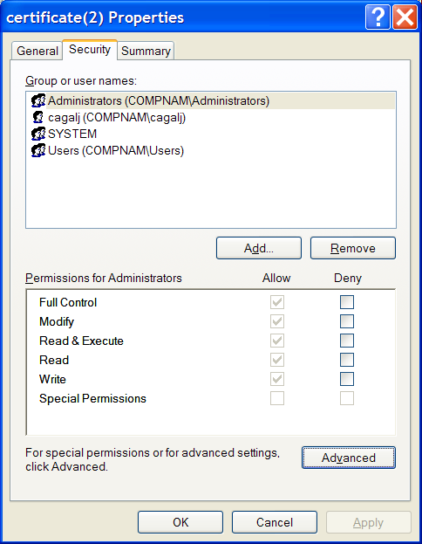
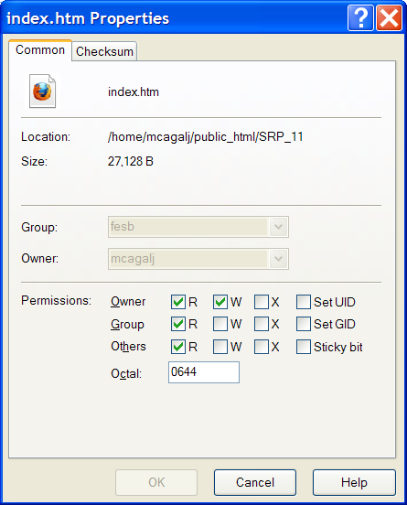
Examples: UNIX and WINDOWS
Windows File Access Control
Unix File Access Control (WinSCP view)

Slide 7
Access Control Policies
DAC
MAC
RAC
Not mutually exclusive
Discretionary Access Control (DAC)
  User-oriented security policy (based on identity of requestor)
  Entity has rights to enable another entity to access a resource
Mandatory Access Control (MAC)
  Access permissions are defined by a system itself
  Based on comparing security labels of system resources (e.g. top security, low security) with security clearances of entities accessing the resources
  Cleared entity cannot pass on access rights to another entity
Role-Based Access Control (RBAC)
  Based on roles that users have within system and on rules stating what accesses are allowed to users in given roles

Slide 8
Access Control Elements
Subject - entity that can access objects
  A process representing user/application
  Often have 3 classes: owner, group, world (other)
Object - access controlled resource
  E.g. files, directories, records, programs, memory segments, pages, directory trees, mailboxes etc
Access right - way in which subject accesses an object
  E.g. read, write, execute, delete, create, search

Slide 9
Discretionary Access Control (DAC)

Slide 10
Discretionary Access Control
User-oriented security policy (based on ID of requestor)
Discretionary because an entity has rights to enable another entity to access a resource
General approach as used in operating systems and database management systems is that of an access matrix
  Lists subjects in one dimension (rows)
  Lists objects in the other dimension (columns)
  Each matrix entry specifies access rights of the specified subject to that object

Slide 11
Access Matrix: Example
Objects
File 1
File 2
File 3
File 4
Own
Read
Write
Own
Read
Write
User A
Access rights
Read
Own
Read
Write
Write
Read
Subjects
User B
Read
Write
Read
Own
Read
Write
User C

Slide 12
Access Matrix Elements: Subjects
Are subject users?
  User – a real world user
  Principal – a unit of access control and authorization
user
principals
subjects

Slide 13
User – Principal
One to many mapping between user and principals
System authenticates user in the context of principal
Shared principals (accounts) are not good for accountability
Alice
Alice.Secret
Bob.Dean
Bob
Bob.Faculty
Bob.Super-user
user
principals

Slide 14
Principal – Subject
One to many mapping between principal and subjects
A subject is a program or application run on behalf of principal
Subjects are often treated the same as principal if all subjects of a principal have the same rights
Email
Alice.Top-secret
Word
Database
principal
subjects

Slide 15
Access Matrix Elements: Objects
An object is anything on which a subject can perform operations (mediated by access rights)
Usually objects are passive, for example
  File
  Directory (or Folder)
  Memory segment
But, subjects can also be objects, with operations
  Kill
  Suspend
  Resume

Slide 16
Access Matrix Elements: Rights
A right specifies what kind of access a subject can perform on an object
  Own
  Read
  Write
  Execute
  Create
  Delete
  Transfer
  ...

Slide 17
Implementation of an Access Matrix
In practice, an access matrix is usually sparse
Therefore implemented by
decomposition in one of two ways
  By columns – Access Control Lists
  By rows – Capability tickets
File 1
File 2
File 3
File 4
Own
Read
Write
Own
Read
Write
User A
Read
Own
Read
Write
Write
Read
User B
Read
Write
Read
Own
Read
Write
User C

Slide 18
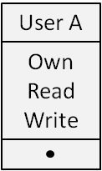
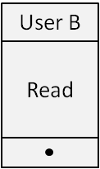
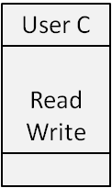
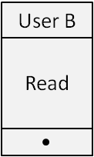
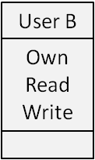
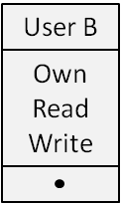
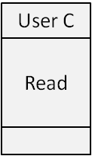
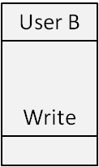
Access Control Lists (ACL)
Each column of access control matrix is stored with corresponding object
File 1
File 4
File 2
File 1
File 2
File 3
File 4
Own
Read
Write
Own
Read
Write
User A
Read
Own
Read
Write
Write
Read
File 3
User B
Read
Write
Read
Own
Read
Write
User C

Slide 19
Access Control Lists (ACL)
Access rights stored with objects
ACL may contain default (public) entries
  If users not explicitelly listed in ACL – default rights (e.g., read only)
  Elements of ACL include individual users as well as groups of users
ACLs are convinient when desired to determine which subjects have which access rights to particular resource
  Not convinient for determining the access rights of a particular user
  UNIX and Windows use ACLs to protect files/processes
ACL requires subjects to be authenticated before access to a particular object!

Slide 20
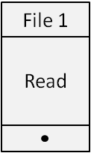
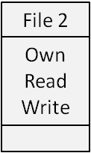
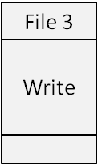
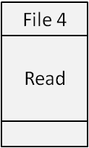
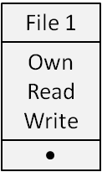
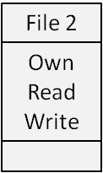
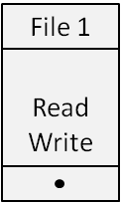
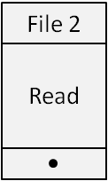
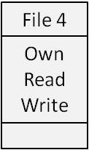
Capability Lists (Capabilities)
Each row of access control matrix is stored with corresponding subject
User B
User A
File 1
File 2
File 3
File 4
Own
Read
Write
Own
Read
Write
User A
Read
Own
Read
Write
Write
Read
User B
User C
Read
Write
Read
Own
Read
Write
User C

Slide 21
Capabilities
Access rights stored with subjects
Capability ticket specifies authorized objects and operations for a particular subject
It is easy to determine the set of access right for a given user
  More difficult to determine the list of users with specific access rights for a specific resource
Each user may have many tickets
  User may be authorized to give them to others
  Tickets may be dispersed around the system, a great security problem
  Unforgability – include an unforgable crypto token (authentication code) in the capability (used in distributed systems – e.g. Kerberos)
Capability tickets require unforgability and capability propagation control!

Slide 22
Comparison of ACL and Capabilities
ACL
  Access rights stored with objects
  Requires authentication of subjects
  Provides access review on a per-object basis
  Most operating systems such as UNIX and Windows use ACL to protect files
Capabilities
  Access rights stored with subjects
  Requires unforgeability of capabilities and propagation control of capabilities
  Provides revocation facilities on a per-subject basis
  Used in authentication systems such as Kerberos

Slide 23
Authorization table
Data structure that is not sparse (like access matrix), but is more convinient than ACL and capabilities
  Sort by Subject
  Sort by Object
Commonly used in
relational database
management
systems
Subject Access right Object
A Read F
A Write F
A Own F
B Read G
B Read F
C Write F
C Own G

Slide 24
Case Study: UNIX File System
3 types of permissions (rights)
  r – read file or directory
  w – write to file or directory
  x – execute file or search directory
3 types of users (subjects)
  u – user who owns file
  g – members of the group to which the owner belongs
  o – all other users
Given a file (object), each of 3 permissions can be set for any of 3 types of users by its owner
  user group others
  r w x r w x r w x
  ls -l file1
  -rwx--x--x 2 Alice staff 2048 Jan 1 12:10 file1
  ls -l dir1
  drwxr-xr-x 3 Alice user 1024 Jan 1 09:27 dir1
  chmod g+r file1

Slide 25
WINDOWS Security Model
The security model involves the following concepts:
  Security identifiers (SIDs) – e.g., S-1-5-21-1454471165-1004336348-1606980848-5555
  Access tokens
  Security descriptors
  Access Control Lists (ACLs)
  Privileges
Events from the time a user logs on, to the time she accesses a secure object
  User logs on successfully and the system creates a logon session representing the security context for the user. Every user’s process contains an access token (SID, defaul privileges, ...) that describes the user’s security context.
  Every process started by the user is passed a copy of the access token.
  When a process attempts to access a secure object (e.g., a file), the system checks the security descriptor (owner, ACL) of the object and use ACL to find a group of user SID that matches the one contained in the access token of the process.
  The user (process) is either granted or denied an access to the object (e.g., if ACL contains deny to SID).

Slide 26
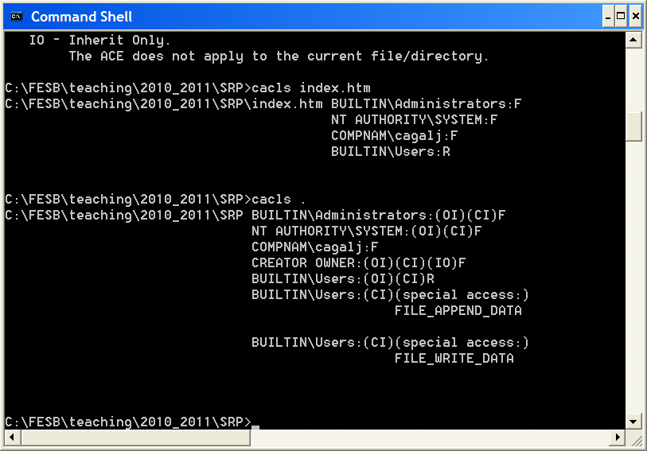
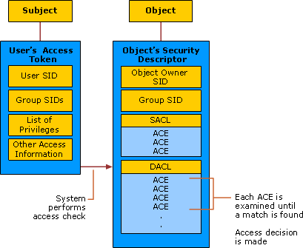
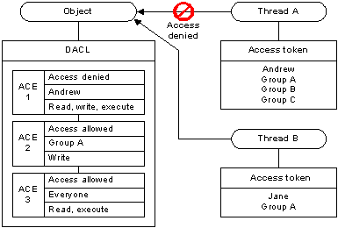
WINDOWS: DACL, Access Control Entries (ACEs), Securable Objects, Processes

Slide 27
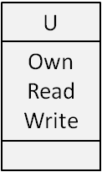
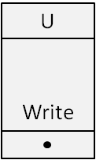
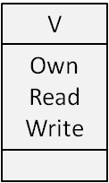
Security Problems of DAC
However, DAC dose not provide real assurance – access restrictions can be easily bypassed
  Trojan horse attack
Read
Principal U
File F
Write
ACLs
Write
Principal V
Read
File G
Principal V is a bad guy who wants to read file F

Slide 28
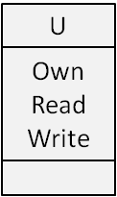
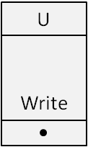
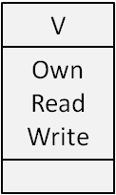
Security Problems of DAC (2)
Principal V sends U a benign software with Trojan horse included
U executes the software → Trojan horse gains U’s privileges
Execute
Trojan horse
Read
Principal U
File F
Benign software
ACLs
Write
Principal V
Read
File G
Principal V can read file F with the help of Trojan horse

Slide 29
Solution to the DAC Security
Mandatory Access Control (MAC)

Slide 30
Mandatory Access Control (MAC)

Slide 31
Mandatory Access Control (MAC)
MAC attaches security labels to subjects and objects
  Security label to subject → security clearance
  Security label to object → security classification
System controls access to resorces by comparing security labels of the resources (e.g. system, high, low security) with security clearances of subjects accessing the resources
Users have no control of security labels (as in DAC)
  Note that cleared entity cannot pass on access rights to another entity (as is the case in DAC)
MAC restricts information flow to certain can-flow paths (depending on the information flow policy)

Slide 32
Controlling Information Flow – Security
Military security classes as security labels
If subject’s level is equal to or greater than the object’s level, the subject is allowed to read the object (read down)
Note that a subject may only write up
Top secret
High level
Secret
Can-flow
Confidential
Low level
Unclassified

Slide 33
Controlling Information Flow – Integrity
Windows © Vista Mandatory Integrity Control (MIC) defines 4 integrity levels: low, medium, high and system
If subject’s level is equal to or greater than the object’s level, subject is allowed to write to or delete object (write down)
Else, can only read if allowed by the ACL (read up)
System
High level
High
Can-flow
Medium
Low level
Low

Slide 34
Bell and LaPadula model (BLP)
A formal MAC model for protection of confidentiality
  D. E. Bell and L. J. LaPadula. Secure computer systems: mathematical foundations and model. MITRE, 1974
Esentially, based on read down and write up principles
We will show later how BLP protects against the Trojan horse attack (information leakage) in the context of DAC

Slide 35
BLP Model (1)
Simple-security property
  Subject S can read object O only if
  Label(S) dominates (>=) Label(O)
  Information can flow from Label(O) to Label(S)
Star-property
  Subject S can write object O only if
  Label(O) dominates (>=) Label(S)
  Information can flow from Label(S) to Label(O)
Read down
Label(S)
Can-flow
Label(O)
Write up
Label(O)
Can-flow
Label(S)

Slide 36
BLP Model (2)
Note
  BLP model is applied to subjects, not users
    Users are trusted
    Subjects are not trusted due to Trojan horses
  Star-property prevents information leakage caused by Trojan horses

Slide 37
Recall the Security Problem of DAC
Principal V sends U a benign software with Trojan horse included
U executes the software → Trojan horse gains U’s privileges
Execute
Trojan horse
Read
Principal U
File F
Benign software
ACLs
Write
Principal V
Read
File G
Principal V can read file F with the help of Trojan horse

Slide 38
BLP Star Property Solves the Problem
Assign a high (sensitive) security label to Principal U and File F and low (public) security label to principal V and File G
Note that the star property overides ACL access rights
Execute
Trojan horse
Read
Principal U
File F
(Label H)
Benign software
ACLs
can-flow
Write
star-proprety
(Label L)
Principal V
Read
File G

Slide 39
MAC in Real Life
Windows © Vista Mandatory Integrity Control (MIC)
  In the context of Internet Explorer, Acrobat Reader etc.
    E.g., user visits malicious website with IE7.0
    Vulnerability in IE7.0 introduces a malicious code on to the host
    The malicious code runs with low privileges (security label)
    Due to Windows MIC, the malicious code cannot access objects with higher security labels
Security-Enhanced Linux (SELinux)
  Use Linux Security Module to implement MAC
  Enforces MAC policies that confine user programs and system servers to minimum amount of privilege they require to do their jobs
AppArmor ("Application Armor")
  A security module for the Linux kernel
  Administrator can associate with each program a security profile that restricts the capabilities of that program

Slide 40
Role-Based Access Control (RBAC)

Slide 41
RBAC
Traditional DAC systems define the access rights of individual users and groups of users
In many organizations (in industry), the user do not own the information for which they are allowed access
  Rather, the coporation is the actual owner of system objects
  Access control is often based on employee job functions (roles) rather than data ownership
  E.g. roles in a hospital: doctor, nurse, pharmacists,...
RBAC is based on the roles that users assume in a corporation/organization (rather than the user’s ID)
  RBAC systems asign access rights to roles
  And users are assigend to different roles

Slide 42
Role
Role represents users
  Specific tack competency
  Job responsibility
  Specific duty assignment
Role defines permissions
  Operator role
  Security officer role
  Auditor role
user
UA: user assignment
role
PA: permission assignment
permission
Sessions (one-to-many mapping)

Slide 43
Users, Roles and Resources
The relationship of users to roles is many to many
The relationship of roles to resources, or system objects is also many to many
Object 1
User 1
member_of
trans_a
Role 1
member_of
User 2
Object 2
trans_b
member_of
User 3

Slide 44
Hierarchical Roles
Roles can be composed of roles
Object 1
User 1
member_of
trans_a
Intern
member_of
User 2
Object 2
trans_b
member_of
User 3
member_of
Object 3
User 4
member_of
trans_c
Doctor
member_of
User 5
Object 4
trans_d
member_of
User 6

Slide 45
Security Management with RBAC
Security management is simpler with roles
  User-role relationship changes over time – the set of users changes frequently (dynamic assignment of users to roles)
  The set of roles in the system is likely to be static
  Role-permission relationship is relatively stable
    The set of resources and the specific access rights associated with a particular role are also likely to change only infrequently
dynamic
stable
user
UA: user assignment
role
PA: permission assignment
permission
flexible
RBAC0 model
Sessions (one-to-many mapping)

Slide 46
Advantages of RBAC
Authorization management
  RBAC breaks authorization task into two independent parts: one which assigns users to roles and one which assigns rights for objects to roles
  User’s change more frequently than roles, easy revocation of rights
Hierarchical roles
Least privilege
  Roles allow a user to sign on with the least privilege required for the particular task at hand
  Users with powerful roles do not need to exercise them until those privileges actually needed
Separation of duties
  No single principle should be given enough privileges to misuse the system on their own
  E.g. two-person operation: 1st any authorized user, 2nd any authorized user different from the 1st (example: banks)

